Slide 1
Chess Club Review 2014-2015 School Year
May 2015

Slide 2
Chess Club Accomplishments This Year - 1
We continue to produce some of the best scholastic chess players in Austin.
including a few graduating 5th graders who have attended the Spicewood Chess Club since kindergarten
Over 50 beginner kindergarten and first graders participated this school year.
Chess Club students participated in and won many individual and team trophies at local scholastic tournaments.
We hosted the Spicewood Scholastic Chess tournament in November with over 400 students attending.
Donated a chess set and a copy of the hardback book Chess for Children to EVERY classroom at Spicewood.
Donated chess sets to the Spicewood YMCA after school program.

Slide 3
Chess Club Accomplishments This Year - 2
Launched the Spicewood Chess Club website at Spicewoodchess.org in March
Opened the phenomenal Spicewood Chess Club Chess Store twice, which is probably the most popular aspect of Chess Club for many students!
Weekly Chess training including presentation of online videos during Club meetings.
Purchased 12 top-of-the-line ZMF chess clocks with functionality that allows kindergartners and other young students to easily operate.
Renewed membership with Chesskid.com for the year and had a large number of Chess Club students register and participate in our Club's online Chesskid contests.
Substantially increased the number of chess books in the Chess Club internal library.
Purchased new triple weighted deluxe chess sets for the Chess Club

Slide 4
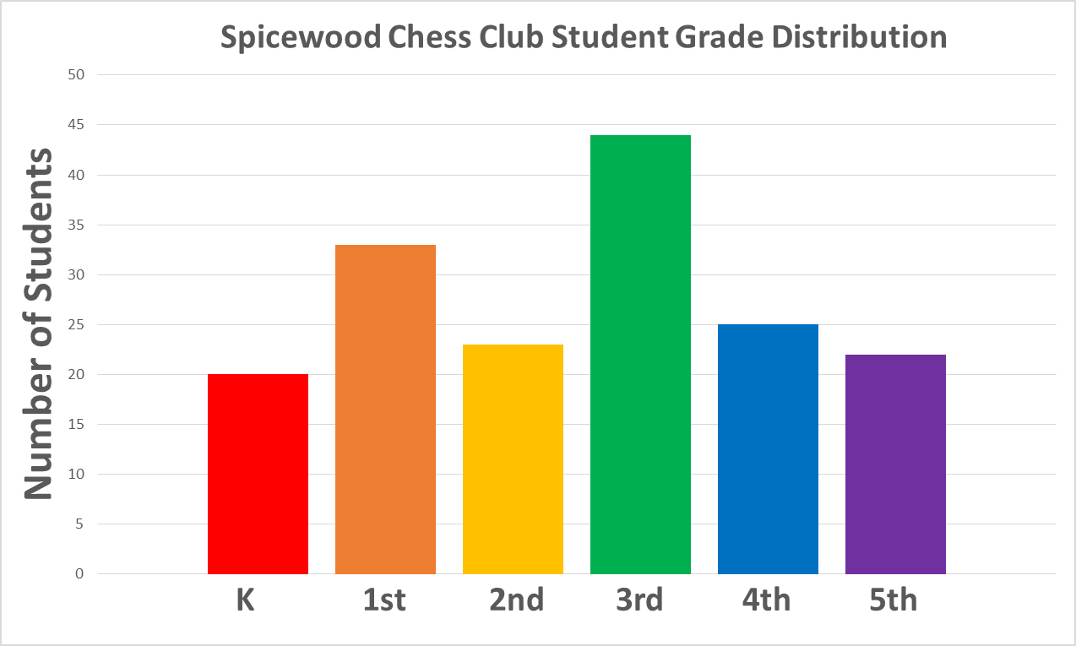
2014-2015 Club Statistics
167 registered students in the Club
Close to 30 Friday morning Club meetings that were well attended. (6:40-7:40AM)
Chess Club students participated in all locally sponsored scholastic tournaments and had great performances. (6 in total)
Increased Chesskid.com active student accounts to ~55.
Club registration fees collected: ~$3610
Tournament income: ~$2270 Tournament expenses: ~$1160

Slide 5
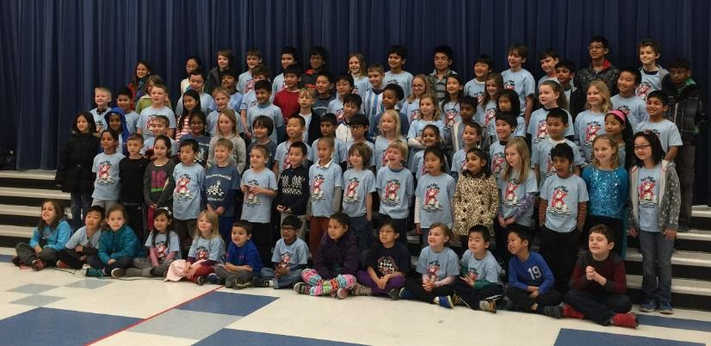
Club T-shirt
T-shirt designed by 4th grade student Noah Kim
We purchased 183 youth and 87 adult shirts for $1362 printed by Aztec Promotional Group (~$5 per shirt)
41 T-shirts donated to Spicewood staff to promote the chess club
25 T-shirts given to Chess Club volunteers
10 Adult T-shirts purchased by parents

Slide 6
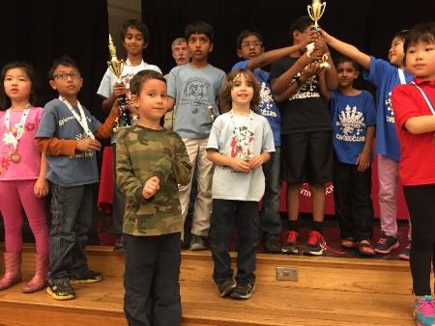
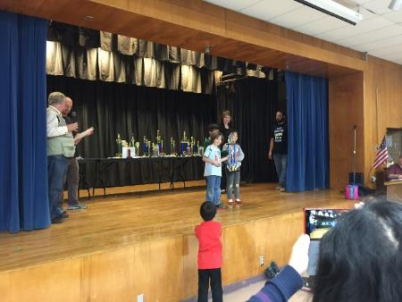
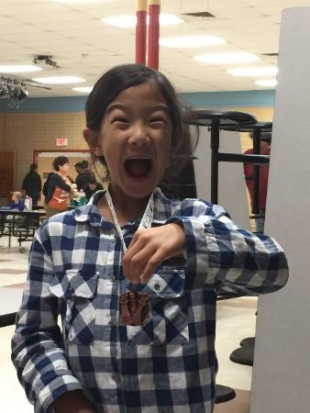
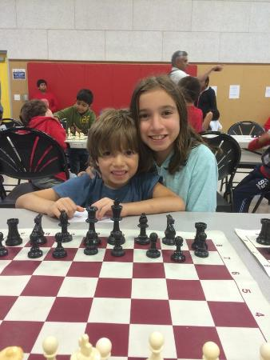
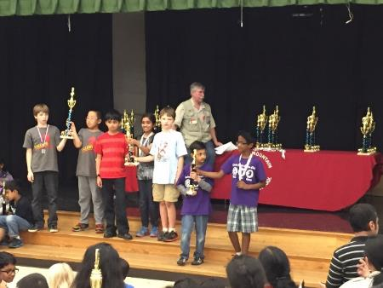
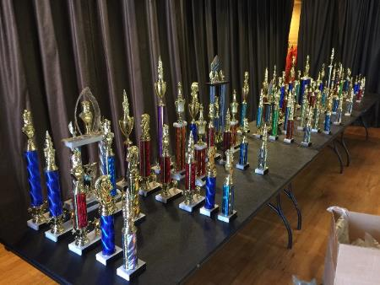
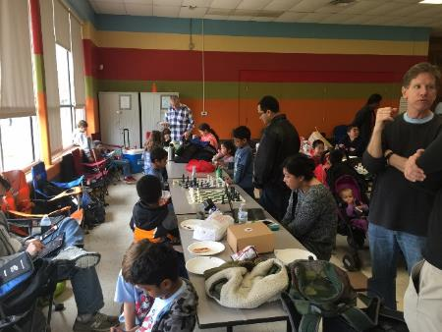
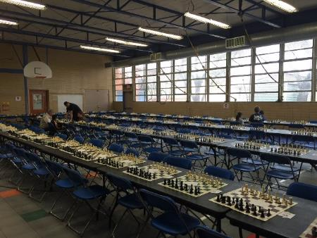
Miscellaneous Tournament Photos

Slide 7
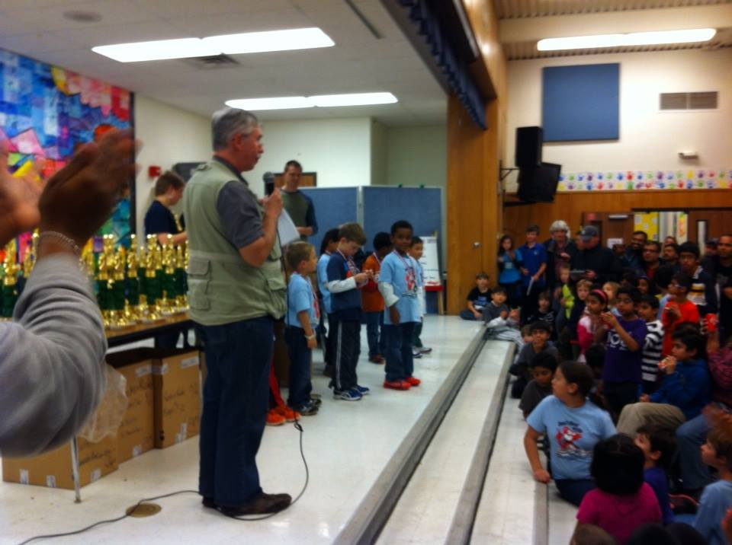
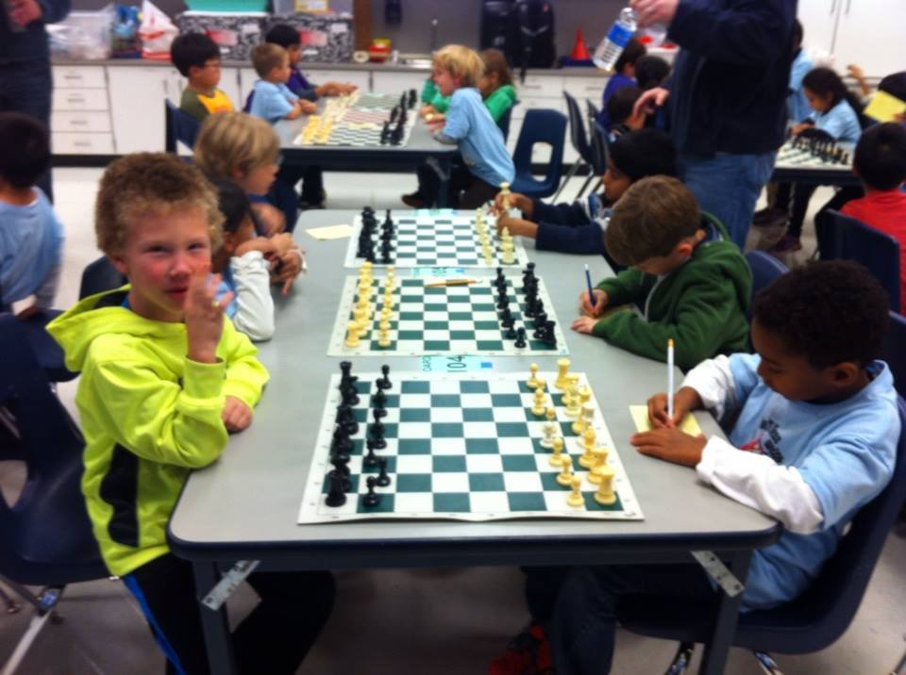
Spicewood Tournament
The Chess Club hosted a local scholastic tournament at our school in November 2014 that was very successful.
Over 400 students from across the Austin area participated in our tournament.
Income exceeded expenses by $1000 from hosting this tournament.

Slide 8
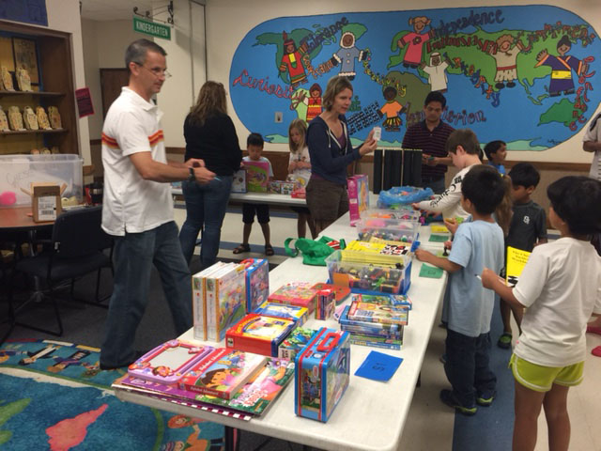
Chess Store
Chess club students receive Chess Bucks for attending our Friday morning club meetings as well as for attending tournaments and participating in our online Chesskids contests.
Twice a year, we open a Chess Store filled with toys, games, books and other fun items for the students to purchase with their collected Chess Bucks.
The Chess Store is a great motivator for our students to encourage them to wake up early on Fridays for our club meetings as well as attend tournaments.
Special thanks to our Chess Store coordinators, Terri Schlosser and Karen Pavlovic

Slide 9
Chess Club Website - Created in March 2015

Slide 10
Chess Club Website - spicewoodchess.org
Designed to improve our communication and training impact.
Weekly posts containing news about meetings, training, tournaments and more.
Individual student Chess group pages with training information.
List of available Chess books from our Club library.
Calendar and Links to local Chess clubs and Chess events.
Instructions on how to use all of our Chess clocks.
Information and videos on the history of Chess.
Information on the Chess and its influence on Art.
Fun pages showing unique Chess sets and Chess game variations.

Slide 11
Finance Planning for Next Year

Slide 12
Common Chess Club Expenses
List of common annual Chess Club expenses:
Club T-shirts (~$1400)
Printing fees for handouts, worksheets, folders, Chess Bucks, bookmarks, book labels, training materials for coaches, etc. (~$400)
Chesskid membership fee ($400 per year for 75 gold accounts)
Food and drinks for weekend events (2 to 4 events per year, $250 each event)
Chess Store items (~$1500)
School sponsor faculty gift ($200)
New chess sets ($12-$20 per set)
New chess books ($10-$30 per book)
New chess clocks ($40-$50 per clock)

Slide 13
Estimated Income for Next Year
Student registration fees (~150 students): ~$3800
Club sponsors: ~$750
Total estimated income for 2015-2016 school year: $4550

Slide 14
Estimated Expenses for Next Year
$1400 for Chess Club shirts
$650 for Saturday Tournament warm- ups/pizza parties
$1500 for Chess Store
$600 for Chess supplies/books/flyers/Chess bucks
$400 for Chesskid.com
Total estimated expenses for 2015-2016 school year: $4550

Slide 15
Parent Request
The Chess Club leadership requests your feedback.
We especially would like to hear from you on these topics:
Should sponsoring a tournament be considered for next year?
How has the Chess Club helped your child?
What would you change about Chess Club?
How you would increase parent involvement in the Club?
What information would you like to see on the website?
Would you be interested in an Adult Chess lesson?
Would you like to learn more about tournaments?
Can you help the Chess Club next year as a volunteer?
Please email your feedback to feedback@spicewoodchess.org

Slide 16
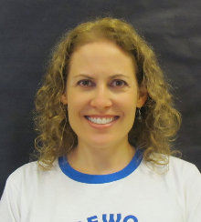
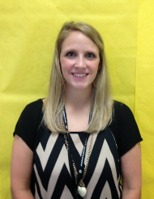
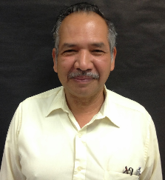
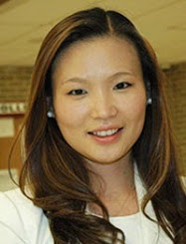
Thank You to Our School Sponsors
The Chess Club would like to thank all of the school faculty and staff for making this year’s Chess Club successful.
We especially want to thank the following people for outstanding support and service:
Laura Reeb
Hernan Benitiz
Courtney Torres
Jiae Kim
We've had a great year and couldn't have done it without their help!

Slide 17
Thank You to All of Our Volunteers
The Chess Club would also like to thank all of our parent volunteers for their hard work and support this year, with special thanks to:
Club coordinator: James McMullen
Club Leadership: Rich Berman, Peter Hardin, Martin Leroy, Shanti Ramasamy and Chris Mason
Coaches: Hong Yang, Joe Norman, Karen Hadzi-Pavlovic, Marlon Revelett, Minh Truong, Natalie Linam, Sujay Sanghavi, Top Changwatchai, Ganesh Sivaraman, Bruce Filgate, Matthew Varner, Ryan Cush, Shovan Kanjilal, Aaron Jones and Stan Wiley
T-shirts: Chris Mason
Chess Store: Terri Schlosser and Karen Pavlovic
Tournament: Shanti Ramasamy and Yumi Kang
Chesskid and Website: Chris Jones
Registration: Shanti Ramasamy
Door Monitor Coordinator: Ganesh Sivaraman

Slide 18
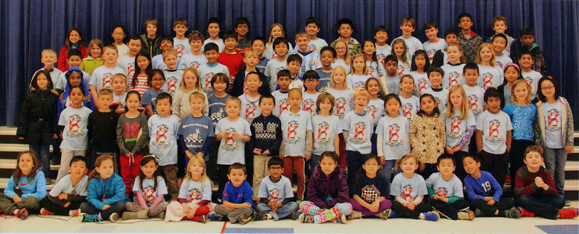
Thank You and See You Next Year

